Slide 1
People detection and counting with Computer Vision
Anthony Galtier

Slide 2
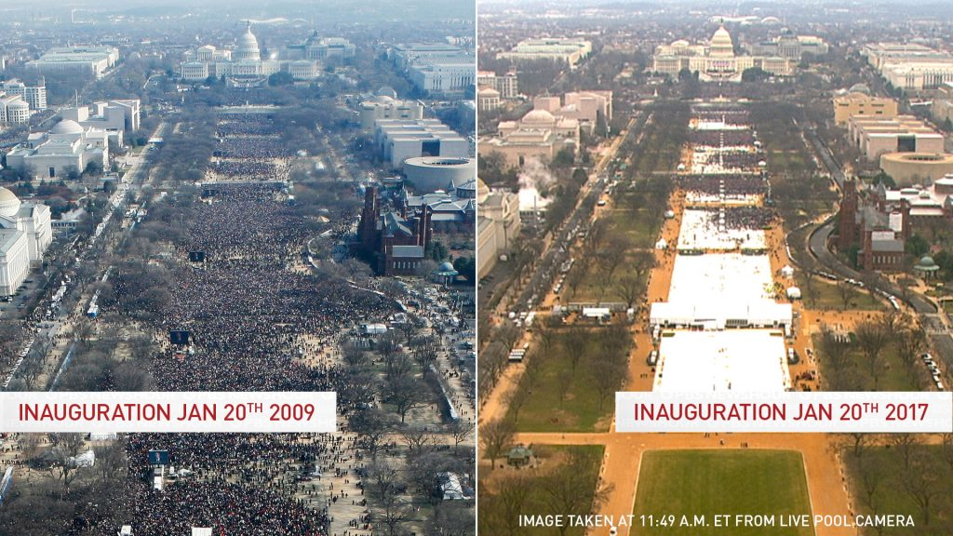
Why count people?

Slide 3
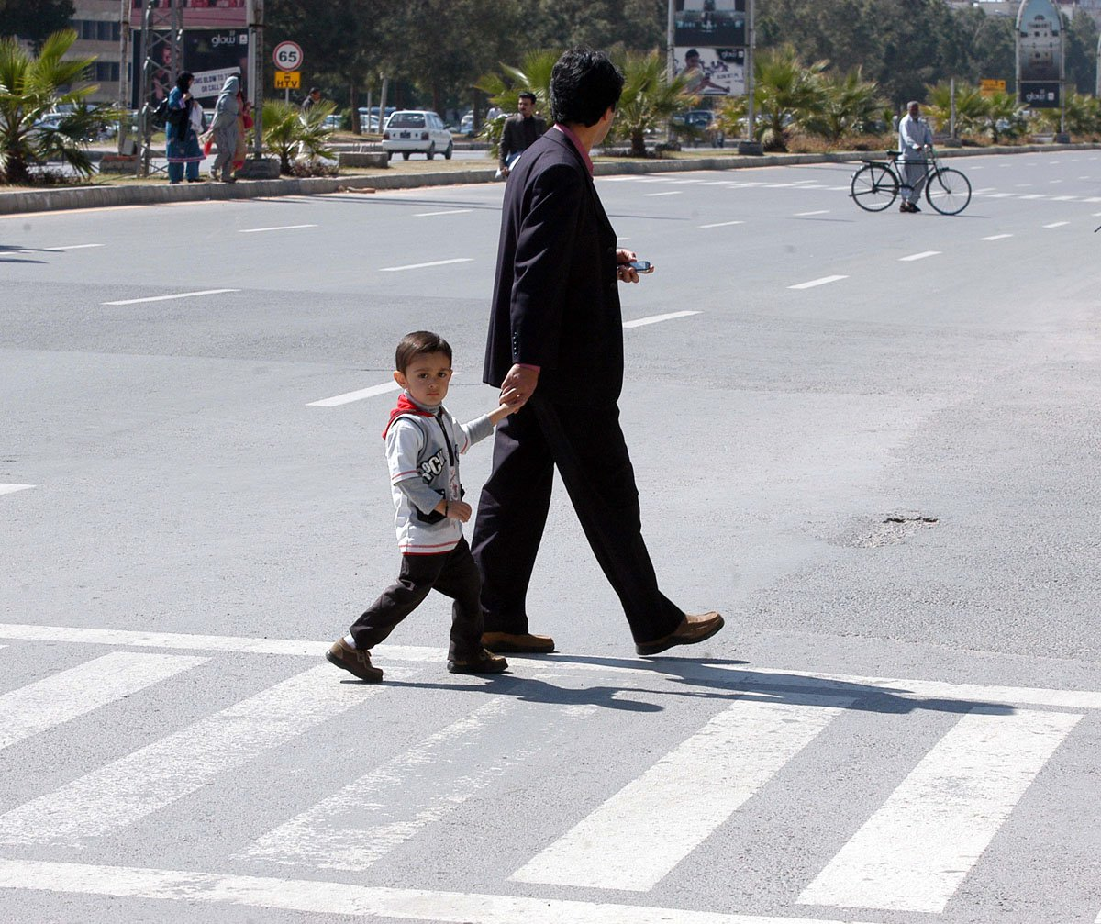
Objectives
To detect people in a given image.
To avoid too much complexity:
Few people
Clear angles
Full unobstructed silhouettes

Slide 4
Object detection methodology
Gather a dataset of labelled images:
Pre-process images
Reshape / Resize / Deskew
Extract significant features
Haar-like features / HOG / SIFT / SURF
Train a classifier
KNN / SVM / AdaBoost
Use trained classifier to detect objects in new images

Slide 5
Solutions found in the academic literature
The Viola-Jones object detection framework
P. Viola and M. Jones. Rapid object detection using a boosted cascade of simple features. CVPR 2001, 2001
Histogram of Oriented Gradient and Support Vector Machines
Navneet Dalal and Bill Triggs, Histograms of Oriented Gradients for Human Detection, CVPR05, 2005
Deep Learning

Slide 6
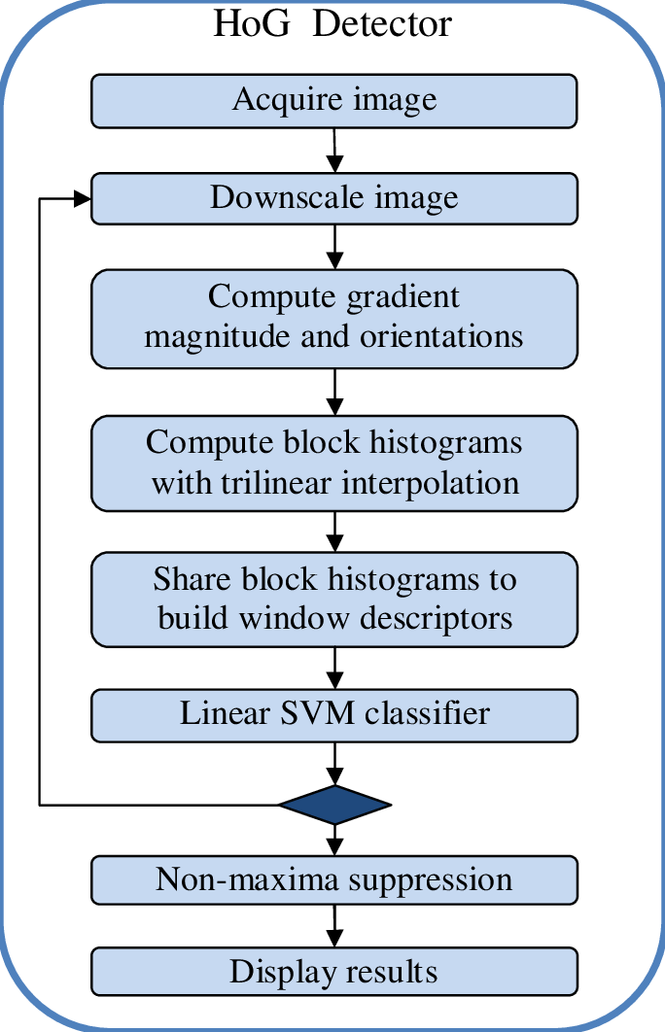
Building a HOG + SVM object detector
Figure downloaded from Berkin Bilgic's paper, Fast Human Detection with Cascaded Ensembles, 2010

Slide 7
Images and pre-processing
Images collected from:
INRIA Person Dataset
Penn-Fudan Database for Pedestrian Detection and Segmentation
Caltech Pedestrian Detection Benchmark
Preprocessing:
Images reshaped to 1:2 aspect
Images resized to 128x64

Slide 8
The HOG descriptor
The SVM classifier
[-1,0,1] and [1,0,1]T kernels
8x8 cells
16x16 blocks
9 bin histograms
70/30 % train/test split
Radial Basis Function kernel
Both Scikit learn and Open CV (LIBSVM) modules tested

Slide 9
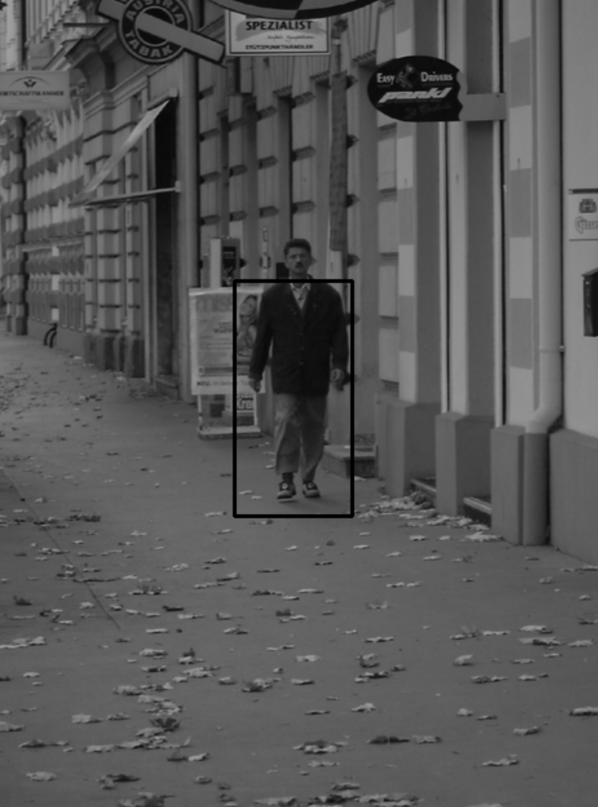
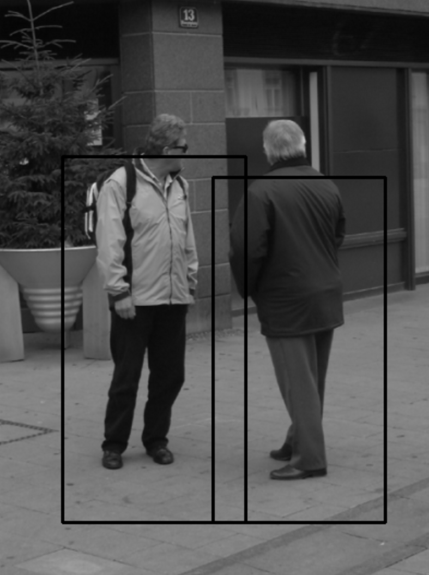
Results
Pre-trained SVM
Over 85 % accuracy
=> Far better results:
-Better dataset
-Refined parameter tuning
Custom trained SVM
Barely 60% accuracy
=> Poor results du to poor dataset
Counting people
Finding the best fitting bounding boxes returned by OpenCV’s HOG detector using
Non Maxima Suppression and counting them

Slide 10
References
P. Viola and M. Jones. Rapid object detection using a boosted cascade of simple features. CVPR 2001, 2001
Navneet Dalal and Bill Triggs, Histograms of Oriented Gradients for Human Detection, CVPR05, 2005
B. Bilgic, Fast Human Detection with Cascaded Ensembles, 2010
Ressources
The Learn OpenCV website by Satya Mallick
Machine Intelligence's object detector guide
The HOG person detector tutorial by Chris McCormick

